Slide 1
Amazon Machine Image(AMI)

Slide 2
AMAZON MACHINE IMAGE (AMI)
When I launch an instance, what software will be installed on it?
Software is taken from an Amazon Machine Image (AMI)
Selected when you launch an instance
Essentially a file system that contains the operating system, applications, and potentially other data
Lives in S3
How do I get an AMI?
Amazon provides several generic ones, e.g., Amazon Linux, Fedora Core, Windows Server, ...
You can make your own

Slide 3
AMAZON MACHINE IMAGE (AMI)
An Amazon Machine Image (AMI) provides the information required to launch an instance, which is a virtual server in the cloud. You specify an AMI when you launch an instance, and you can launch as many instances from the AMI as you need. You can also launch instances from as many different AMIs as you need.
An AMI includes the following:
A template for the root volume for the instance
(for example, an operating system, an application server, and applications)
Launch permissions that control which AWS accounts can use the AMI to launch instances
A block device mapping that specifies the volumes to attach to the instance when it's launched

Slide 4
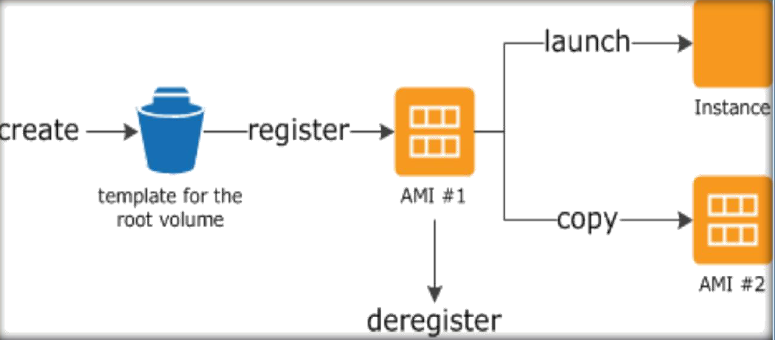
USING AN AMI
The following diagram summarizes the AMI lifecycle. After you create and register an AMI, you can use it to launch new instances. (You can also launch instances from an AMI if the AMI owner grants you launch permissions.) You can copy an AMI to the same region or to different regions. When you are finished launching instance from an AMI, you can deregister the AMI.

Slide 5
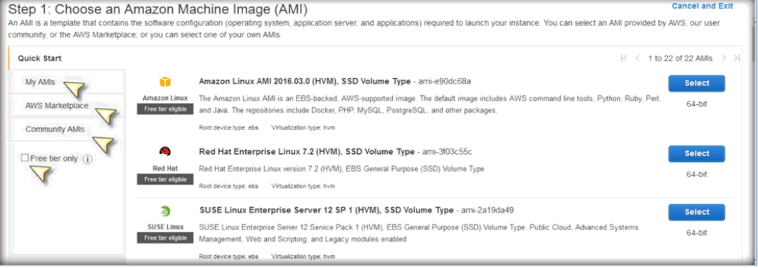
CHOOSING AN AMI
Once you click on Launch instance on Instance s page under EC2, you will get the following screen with
A bunch of options see the options which has highlighted with arrow marks.
Quick Start: Will give you a bunch of AMI’s which related to most daily used Operating systems AMI’s.

Slide 6
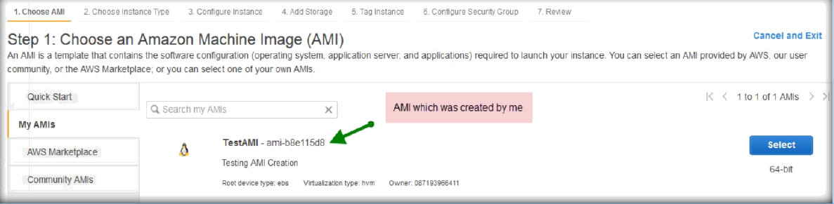
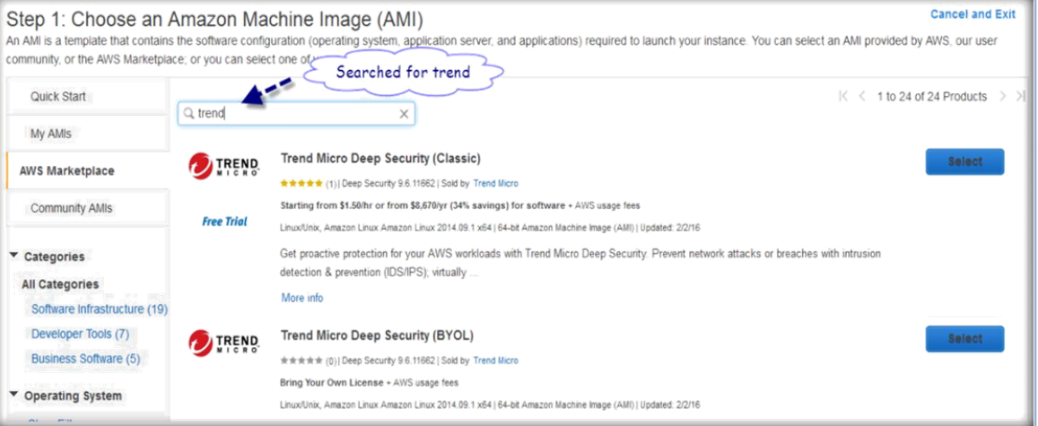
My AMIs: This will give you the list of AMIs which you have taken from the instances.
AWS Marketplace: Will give you a list of AMIs shared by different vendors and third party where you can buy or pay some amount to AWS to use those AMI.
You can see the below screen shot where I have searched for Trend micro.

Slide 7
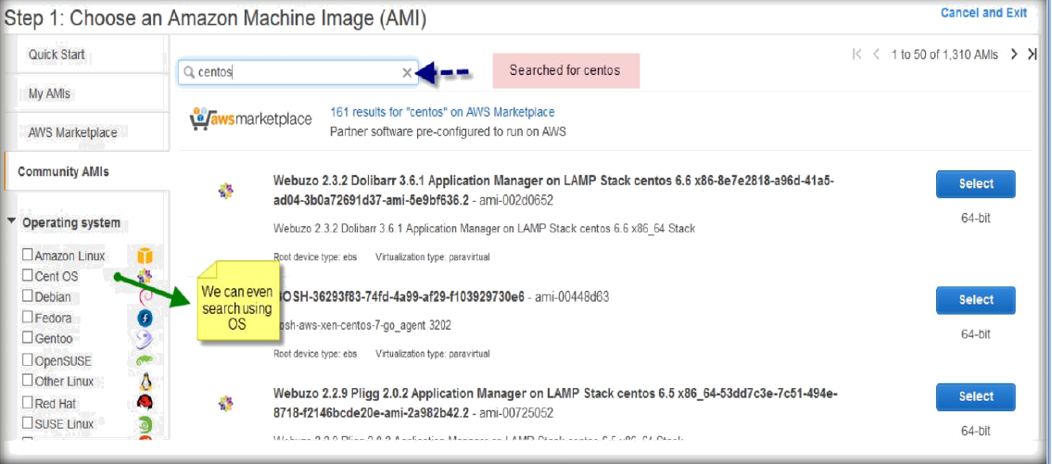
Community AMIs: Will give you a list of AMIs which was shared by different communities such as Fedora, Open SUSE, CentOS etc.
Free tier Only: Will display the AMIs which are applicable under Free tier only.

Slide 8
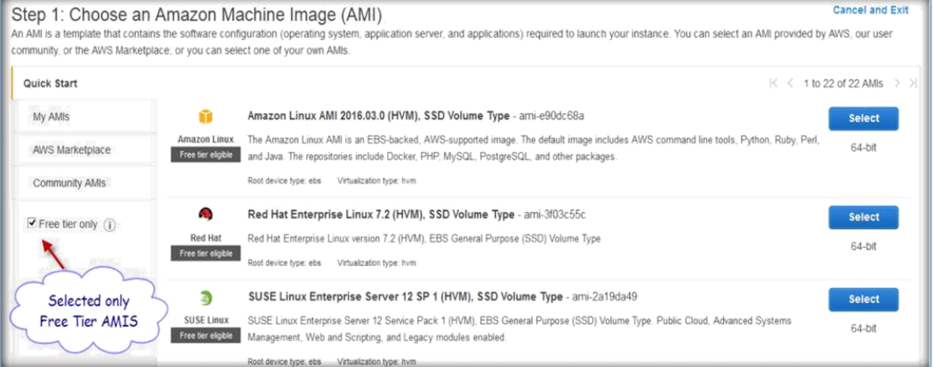
CREATE AMI FROM EXISTING INSTANCE
Once you logged in to AWS management console go to EC2 and under EC2 select Instances.
Under Instances select the instance you want to take an AMI and click on Actions.

Slide 9
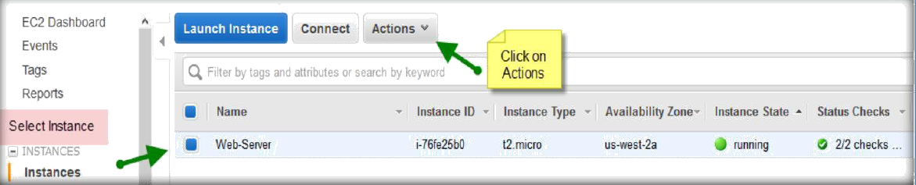
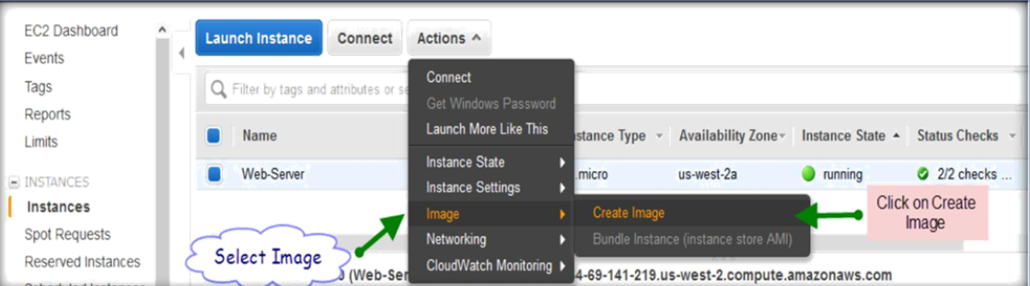
Under the Actions, click on Image and then select Create Image to create AMI.
On the window specify a name to AMI and add a description.
And select No reboot if you want your server not to reboot while creating an AMI image. (It’s advisable to reboot while taking AMI). Then click on click on Create Image to start creating an AMI.

Slide 10
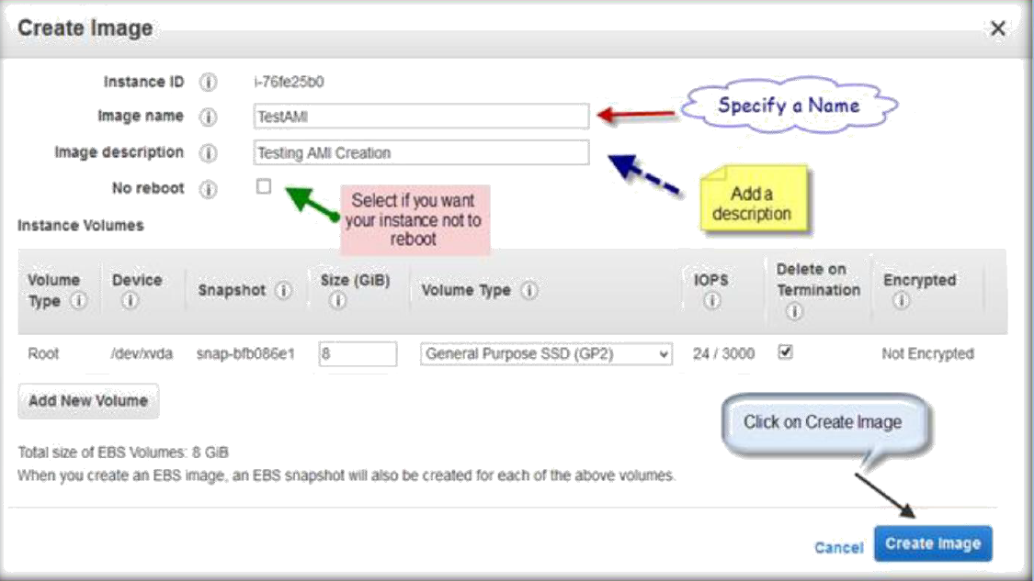
Then you will be displayed with popup window having newly creating AMI ID and the link.
By clicking the link, you can go to the AMI screen where all AMIs are available which were specific to your account.

Slide 11
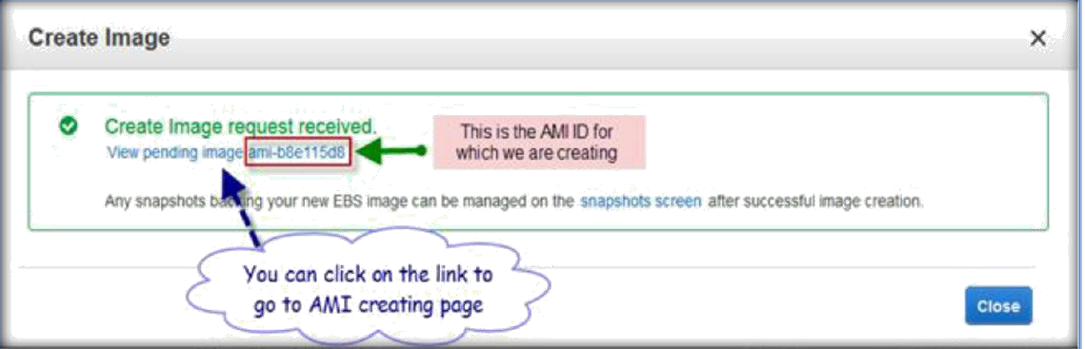
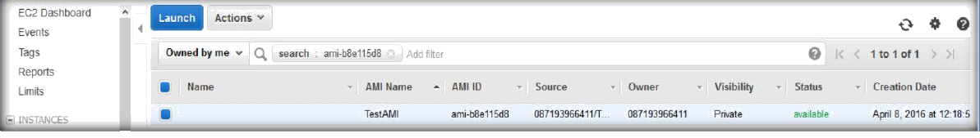
Once you will be on the AMI page you can see the AMI which were created.
AMI PAGE ON EC2 CONSOLE
Once you are in EC2, under EC2 go to the section IMAGES on the left pane and click on AMIs.

Slide 12
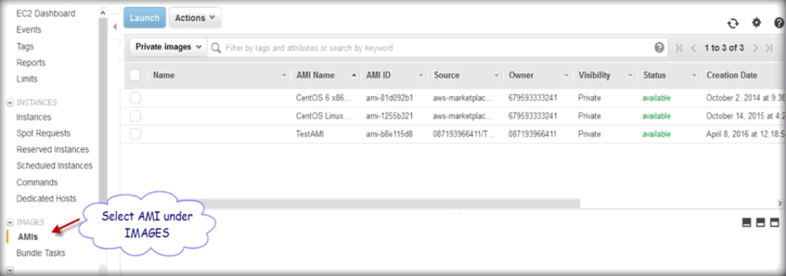
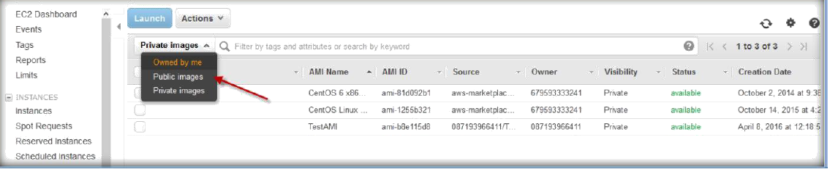
On the AMI page we have three different types of AMIs to select.
Owned by me: AMIs which were created by me.
Public Images: AMIs which were created and shared with public.
Private images: AMIs which were created by someone and given permission to your account.

Slide 13
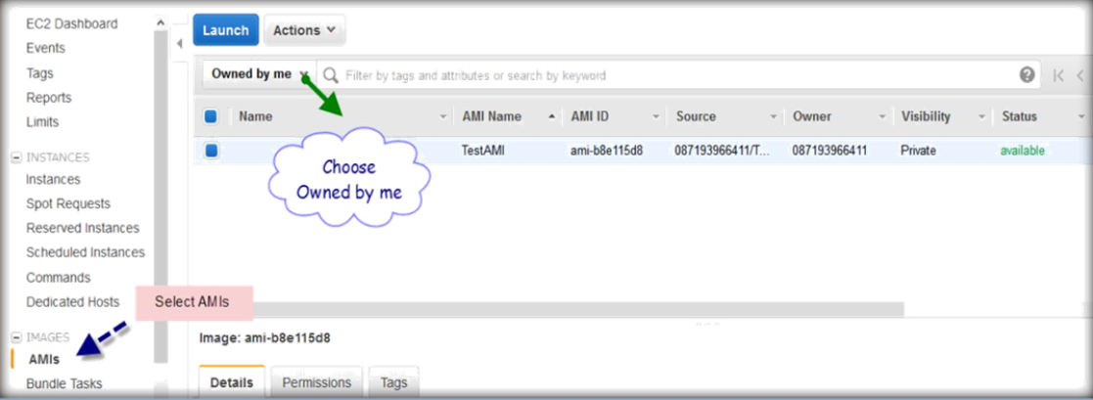
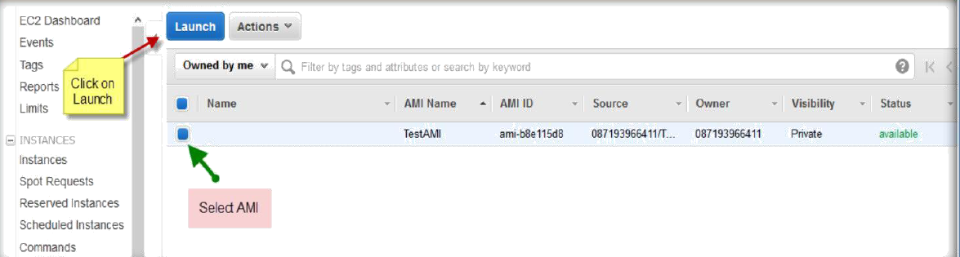
DEPLOYING NEW INSTANCE FROM CREATED AMI
Once you logged in to AWS, go to IMAGES on the left pane under EC2 section.
Choose AMI sorting by Owned by me.
Select your created AMI and click on Launch.

Slide 14
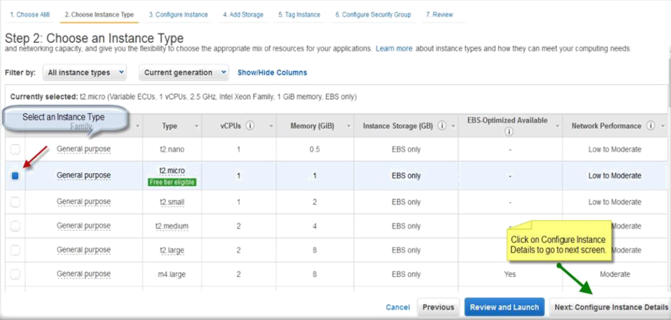
Select instance type and click on Next: Configure Instance Details to go to next screen.
Do not change any configurations in this menu and click Next to Add Storage.

Slide 15
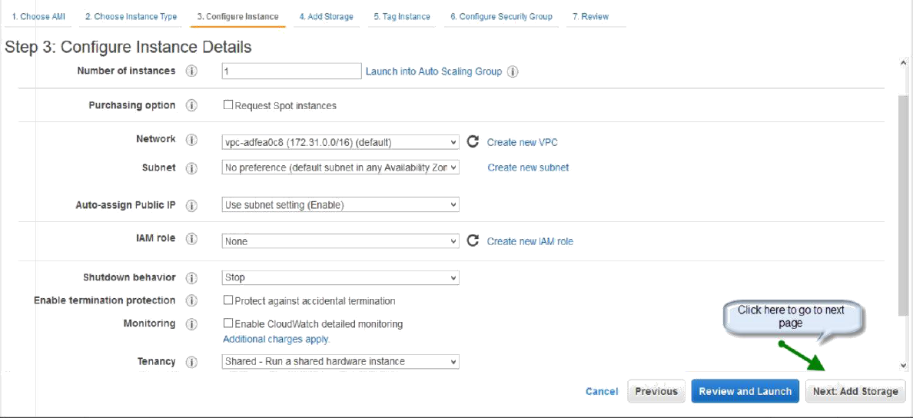
Specify the ROOT volume size in GB’s and click on Next.

Slide 16
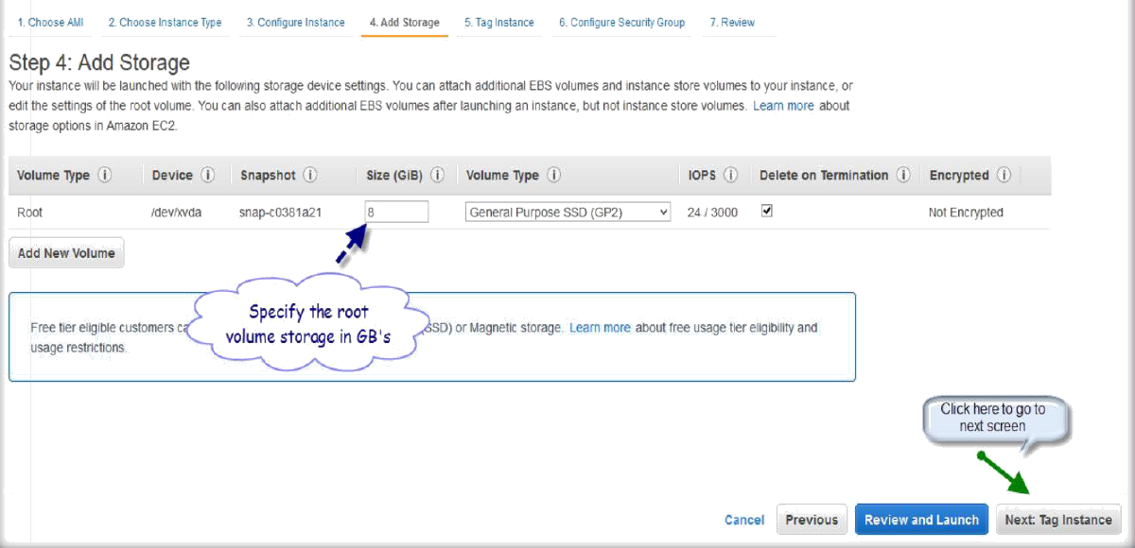
Specify a tag to your instance and click next.

Slide 17
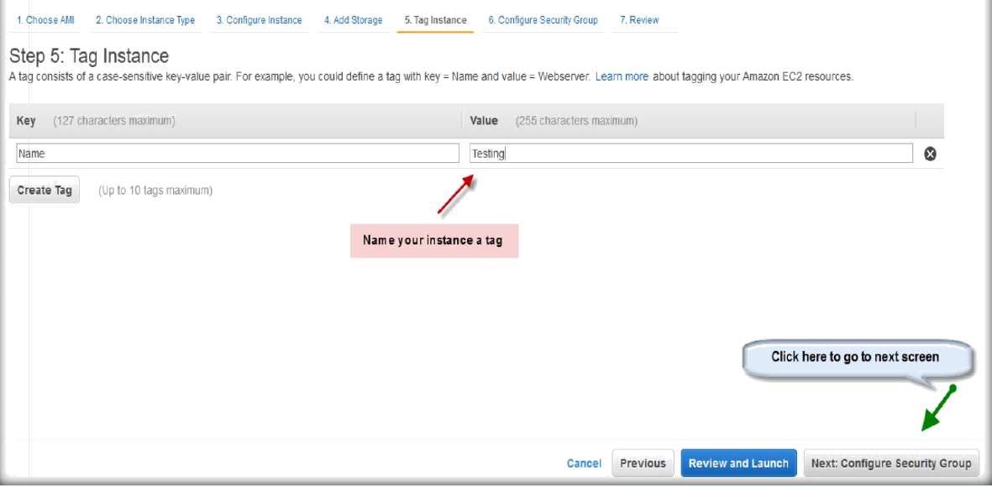
Click on Create a new security group, add a name and description to the security group and click on Review and launch.

Slide 18
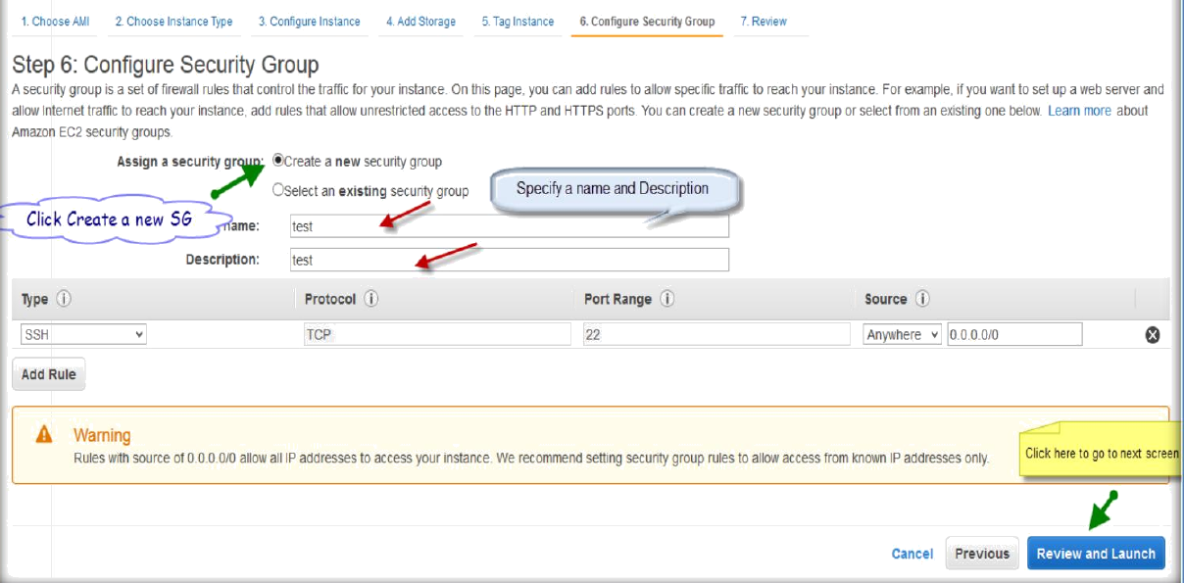
Cross check all your settings for your instance and click on Launch.

Slide 19
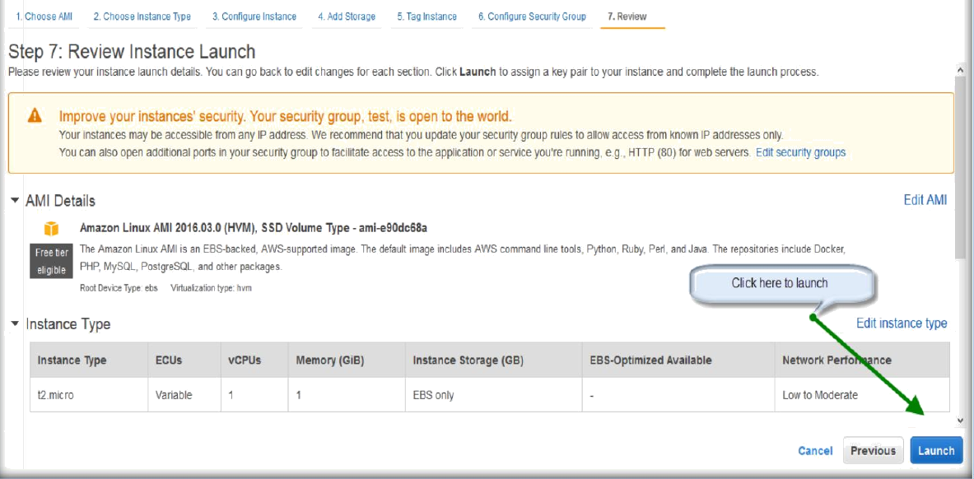
Select choose an existing key pair from dropdown list to get the existing key pairs.
Choose the existing key pair and then click on acknowledgement then click Launch instance.

Slide 20
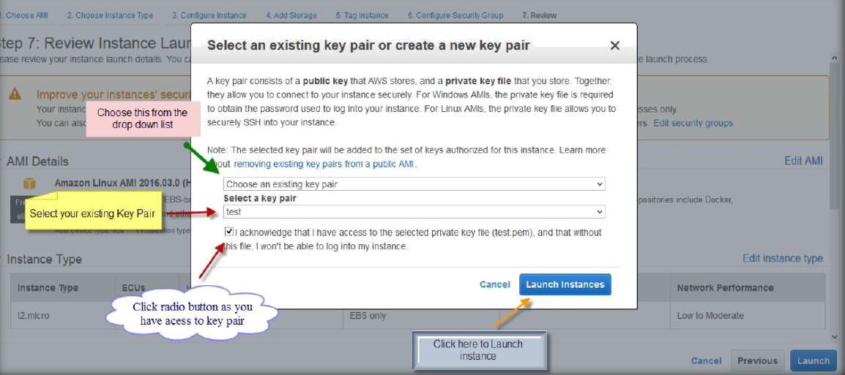
Click on View instances to see the instance which is creating.

Slide 21
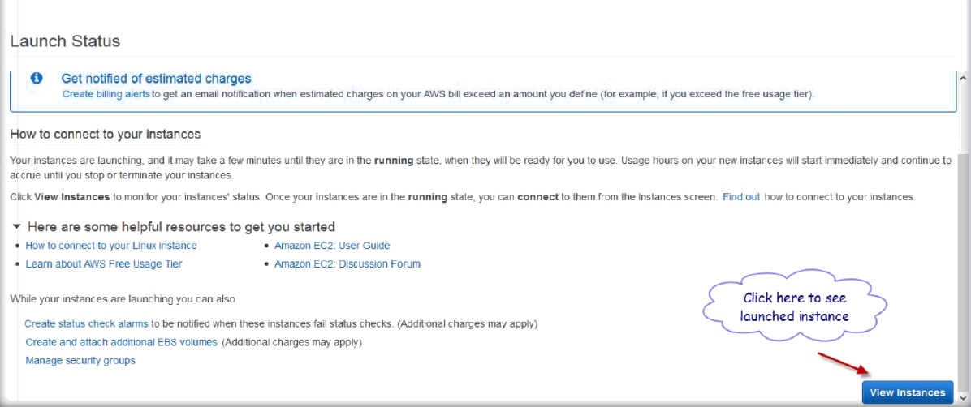
You can see the instance which is creating under instances tab.

Slide 22
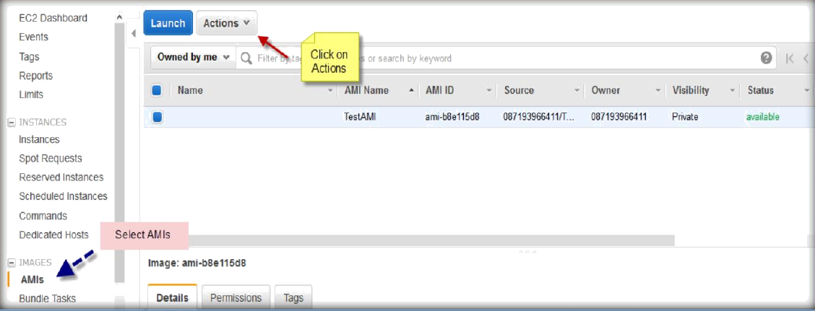
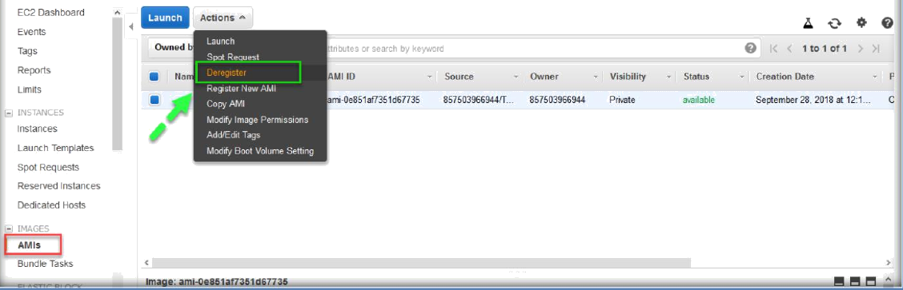
TERMINATING AMI
Go to the AMI section under EC2 under IMAGES and select the AMI
and click on Actions.
Then under the Actions, select Deregister to terminate the instance.

Slide 23
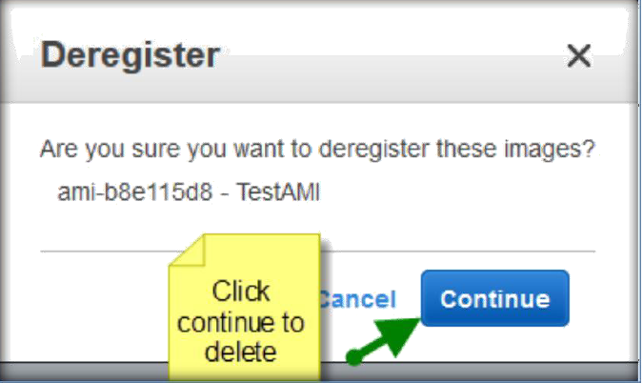
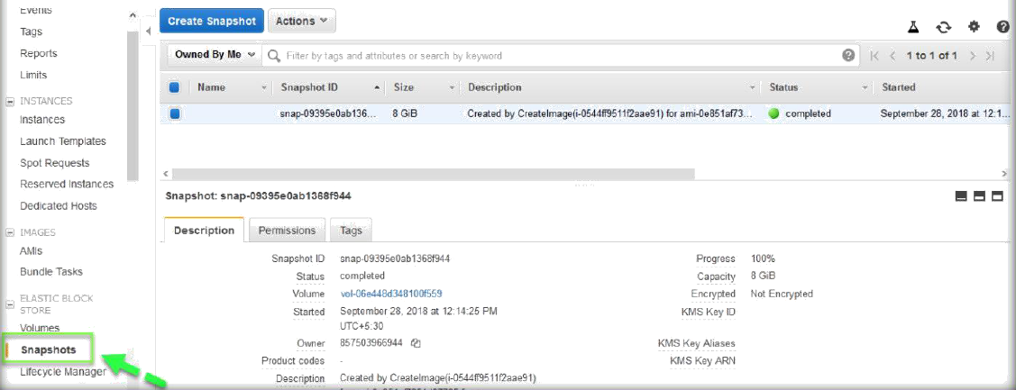
A popup window will ask you for the confirmation to terminate then click continue to complete the AMI termination.
Next, we need to go to snapshots section under Elastic Block Store section.

Slide 24
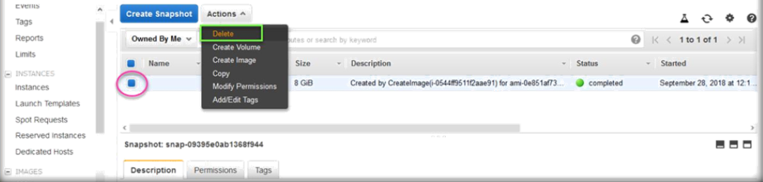
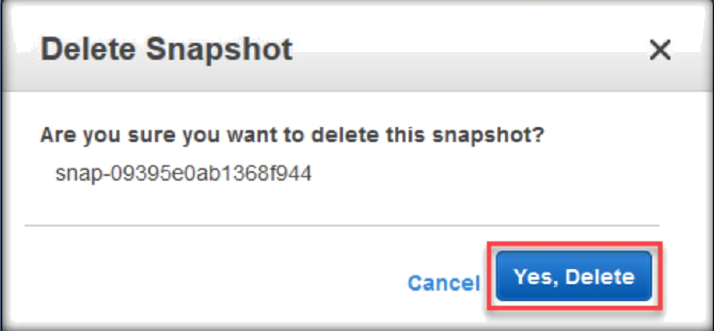
Select the snapshot then choose Delete from the Actions drop down list.
Next, click on Yes, delete to delete the snapshot which completes the deletion of AMI.

